Slide 1
LASER
&
Holography
by
Dr. Kamalpreet Kaur

Slide 2
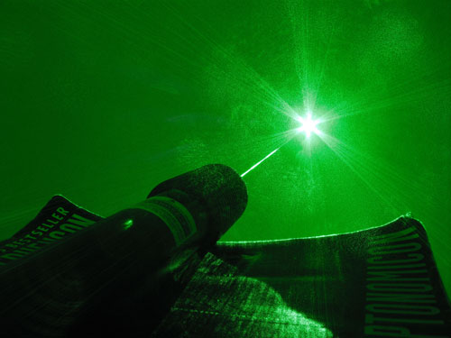
Laser Light
“LASER” = Light Amplification by Stimulated Emission of Radiation

Slide 3
What is Laser?
Light Amplification by Stimulated Emission of Radiation
A device produces a coherent beam of optical radiation by stimulating electronic, ionic, or molecular transitions to higher energy levels
When they return to lower energy levels by stimulated emission, they emit energy.

Slide 4
Properties of Laser
Monochromatic
Concentrate in a narrow range of wavelengths (one specific colour).
Coherent
All the emitted photons bear a constant phase relationship with each other in both time and phase
Directional
A very tight beam which is very strong and concentrated.

Slide 5
Basic concepts for a laser
Absorption
Spontaneous Emission
Stimulated Emission
Population inversion

Slide 6
Absorption
E₂
E₁
Energy is absorbed by an atom, the electrons are excited into higher energy state.

Slide 7
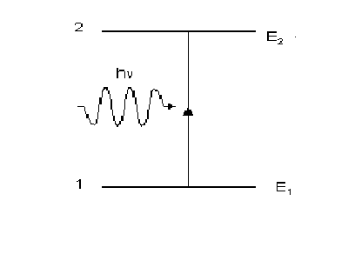
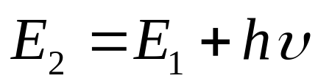
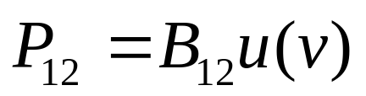
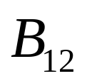
Absorption
The probability of this absorption from state 1 to state 2 is proportional to the energy density u(v) of the radiation
where the proportionality constant is known as the Einstein’s coefficient of absorption of radiation.

Slide 8
Spontaneous Emission
The electron decays from level 2 to level 1 through the emission of a photon with the energy hv. It is a completely random process.

Slide 9
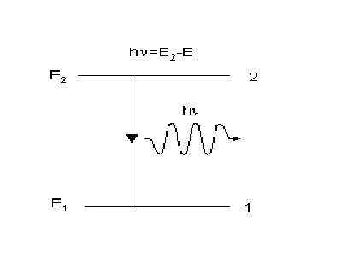
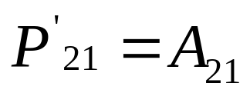
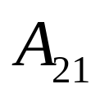
Spontaneous Emission
The probability of occurrence of this spontaneous emission transition from state 2 to state 1 depends only on the properties of states 2 and 1 and is given by
where the proportionality constant is known as the Einstein’s coefficient of spontaneous emission of radiation.

Slide 10
Stimulated Emission

Slide 11
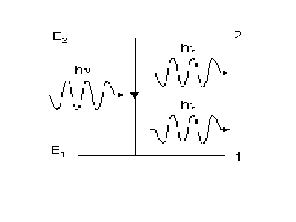
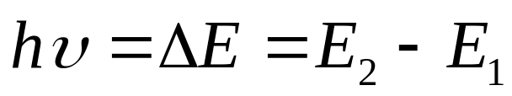
Stimulated Emission
electrons in an upper energy level can be triggered or stimulated in phase by an incoming photon of a specific energy in same direction.

Slide 12
Stimulated Emission
The stimulated photons have unique properties:
  In phase with the incident photon
  Same wavelength as the incident photon
  Travel in same direction as incident photon

Slide 13
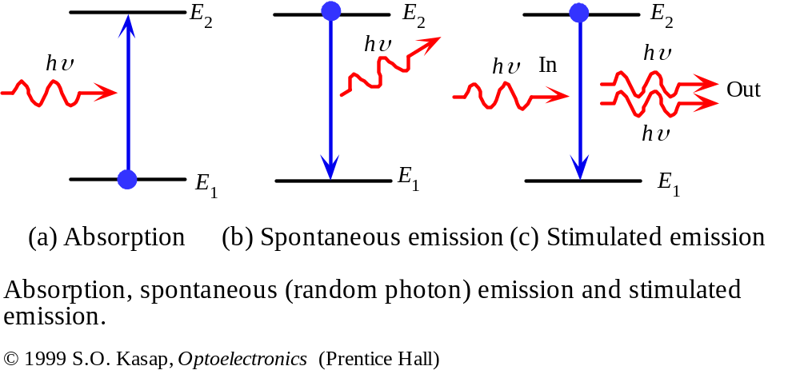

Slide 14
Stimulated emission leads to a chain reaction and laser emission
If a medium has many excited molecules, one photon can become many.
Excited medium
This is the essence of the laser.

Slide 15
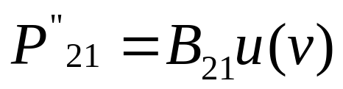
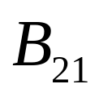
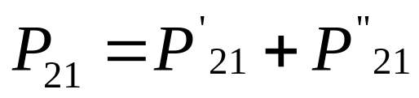
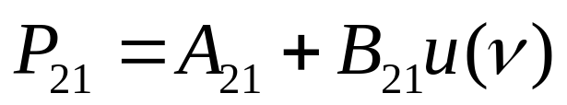
Stimulated Emission
The probability of occurrence of stimulated emission transition from
the upper level 2 to the lower level 1 is proportional to the energy density u(v) of the radiation and is given by
where the proportionality constant is known as the Einstein’s coefficient of stimulated emission of radiation.
Thus the total probability of emission transition from the upper level 2 to the lower level 1 is

Slide 16
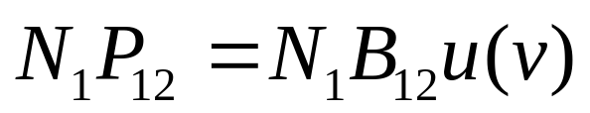
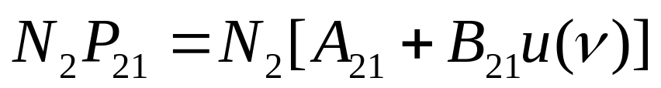
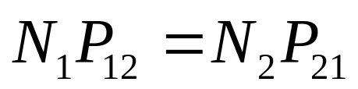
Relation between Einstein’s Coefficients
Let N₁ and N₂ be the number of electrons at any instant in the state 1 and 2, respectively. The probability of absorption transition for electrons from state 1 to 2 per unit time is
The probability of transition of electrons from state 2 to 1,either by spontaneously or by stimulated emission per unit time is
In thermal equilibrium at temperature T, the emission and absorption probabilities are equal and thus

Slide 17
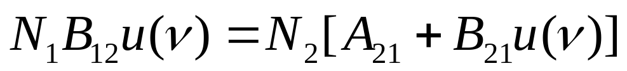
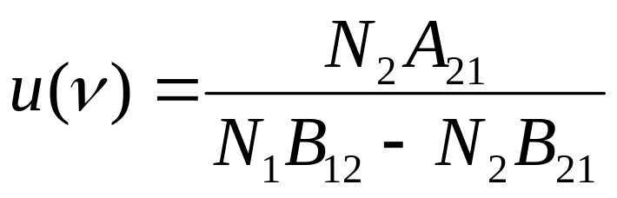
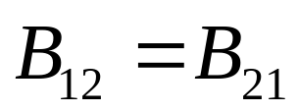
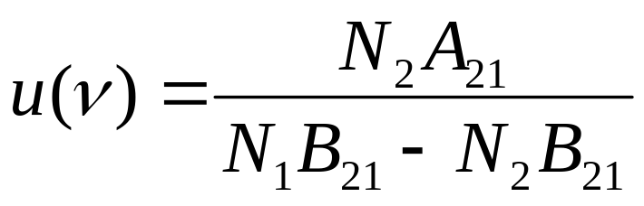
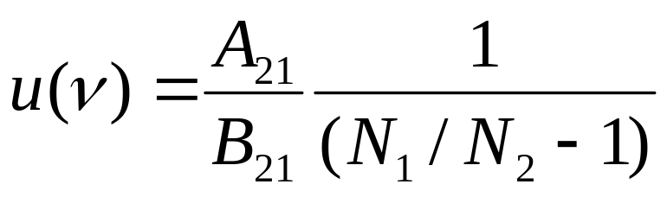
But Einstein proved thermodynamically that probability of (stimulated) absorption is equal to the probability of stimulated emission, So

Slide 18
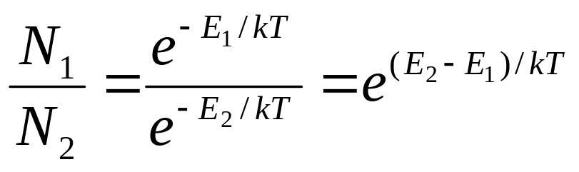
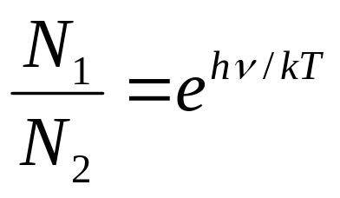
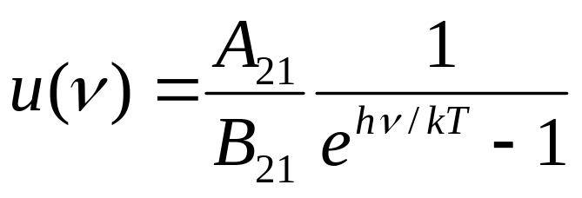
According to Boltzmann’s law, the distribution of electrons among the energy states E₁ and E₂ at the thermal equilibrium at temperature T is given by
where k is the Boltzmann constant
(1)

Slide 19
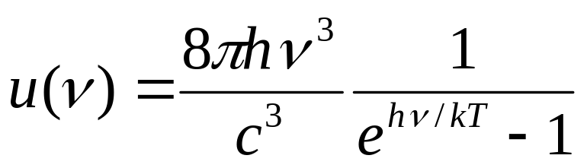
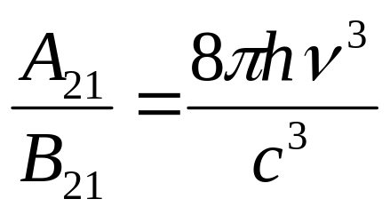
Planck’s radiation formula gives the energy density of radiation u(v) as
(2)
from equation (1) and (2)
This equation gives the relation between the probabilities of spontaneous and stimulated emission.

Slide 20
Condition for the laser operation
If N₁ > N₂
radiation is mostly absorbed
spontaneous radiation dominates.
if N₂ >> N₁ - population inversion
most electrons occupy level E₂, weak absorption
stimulated emission prevails
light is amplified
Necessary condition:
population inversion

Slide 21
Population Inversion
This situation in which the number of electrons in the higher state exceed that in the lower state (N₂ > N₁) is known as population inversion.
Pumping
The process of moving the electrons from their ground state to an excited state is called pumping. The objective is to obtain a non-thermal equilibrium.
Optical
Pumping
Electrical
Pumping

Slide 22
Optical Pumping
The electrons are excited by bombarding them with photons
example: Ruby Laser
Electrical Pumping
The electrons are excited by Electron collision in a discharge tube.
example: He-Ne Laser

Slide 23
Generating a population inversion
“Pumping”: delivery of energy to produce a population inversion
E₃
E₄
E₂
rapid relaxation
rapid relaxation
E₃
pump
pump
lasing
E₂
pump
lasing
lasing
E₂
E₁
rapid relaxation
E₁
E₁
Two-level system
Three-level system
Four-level system

Slide 24
Lasers that maintain a population inversion indefinitely produce continuous output – termed CW (for continuous wave) lasers
Lasers that have a short-lived population inversion produce pulsed output – these are pulsed lasers

Slide 25
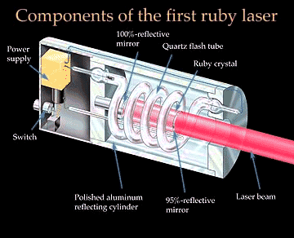
Ruby Laser (Three Level Laser)
Ruby (Al₂O₃) monocrystal, Cr doped.
Xenon Flash Light tube
Partially
silvered mirror

Slide 26
Ruby Laser
Short-live state
10⁻⁸sec
E₃
Radiation-less Transition
Optical
Pumping
10⁻³sec
Metastable state
E₂
5500 Å
Stimulated
Emission
6943 Å
Spontaneous
Emission
6943 Å
6943 Å
E₁
Ground State

Slide 27
Drawbacks of ruby laser
The laser requires high pumping power.
The efficiency of ruby laser is small.
The laser output is not continuous. The output occurs in form of pulses of microsecond duration.

Slide 28
Gas laser
For continuous laser beam, gas lasers are used.
The vapour metal ions are employed as active media.
Main advantage is exceptionally high monochromaticity, most pure spectrum and high stability of frequency.
The output of gas lasers is moderate but inferior to that of crystal lasers.

Slide 29

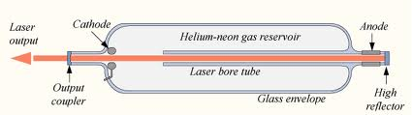
He-Ne Laser

Slide 30
He-Ne Laser
Energy
Transfer
Metastable state
20.61 eV
20.66 eV
6328 Å
6328 Å
6328 Å
Electron
Impact
18.70 eV
c
Spontaneous
Emission
c
Radiation-less
Transition
Ground
State
He
Ne

Slide 31
Ruby Laser
Solid –State Laser
Three Level Laser
Pulsed Laser
Operation duration is only of few hours
He-Ne Laser
Gas Laser
Four Level Laser
Continuous Laser
Operation duration is of ~ 10,000 hours

Slide 32
Ruby Laser
Optical Pumping
Coolent required
High Power of 10 kW
He-Ne Laser
Electrical pumping
Coolent not required
Low Power of about 0.5 – 5 mW

Slide 33
Applications of Laser
Laser beams are very intense so are used for welding, cutting of materials.
Lasers are used for eye surgery, treatment of dental decay and skin diseases.
Lasers are used for barcode scanners in library and in super markets.
Laser is used in printers (Laser printers).
Lasers are used for Nuclear Fusion.
Laser are used in CD/DVD Player
Laser is used in Holography.
Laser torch are used to see long distant objects.

Slide 34

Holography
Holography is the production of three-dimensional images of objects. It is also called photography of wavefront reconstruction.
The physics of holography was developed by Dennis Gabor in 1947. He was awarded the 1971 Nobel Prize.
The laser (1960s) met the requirement of coherent light needed for making holographic images.
Notes:
GREEK: Holos + grafe = whole + drawing

Slide 35
Holography
In Holography both the amplitude and phase components of light wave are recorded on a light sensitive medium such as a photographic plate.
Holography is a two step process.
In First step is the recording of the Hologram where the object is transformed into a photographic record.
Second step is the reconstruction in which the Hologram is transformed into the image.
Notes:
GREEK: Holos + grafe = whole + drawing

Slide 36
Principle of Holography
Holography is the interference between two waves, an object wave which is the light scattered from the object and the reference wave, which is the light reaching the photographic plate directly.
The film records the intensity of the light as well as the phase difference between the scattered and reference beams.
The phase difference results in the 3-D perspective.
Notes:
GREEK: Holos + grafe = whole + drawing

Slide 37
Conventional vs. Holographic photography
Conventional:
  2-d version of a 3-d scene
  Photograph lacks depth perception or parallax
  Phase relation (i.e. interference) are lost

Slide 38
Conventional vs. Holographic photography
Hologram:
  Freezes the intricate wavefront of light that carries all the visual information of the scene
  Provides depth perception and parallax
  Gives information about amplitude as well as phase of an object.
  The hologram is a complex interference pattern of microscopically spaced fringes

Slide 39
Construction of Hologram
Mirror
Reference Beam
Incident
Laser
Beam
Object
Photographic Plate (Hologram)
Object Beam

Slide 40
Reconstruction of Hologram
Laser
Beam
Hologram
Virtual Image
Real Image

Slide 41
Holography
A hologram is best viewed in coherent light passing through the developed film.
The interference pattern recorded on the film acts as a diffraction grating.
By looking through the hologram, we see virtual image.

Slide 42

National Geographic
First major publication to put a hologram on its cover
March 1984 issue carried nearly 11 million holograms around the world

Slide 43
Applications of Holography
Design of containers to hold nuclear materials
Credit cards carry monetary value
Supermarket scanners
Optical Computers
Improve design of aircraft wings and turbine blades
Used in aircraft “heads-up display”
Art
Archival Recording of fragile museum artifacts

Slide 44
Holography goes Hollywood
Holodeck from Star Trek Holodeck Clip
Star Wars Chess Game
Body Double in Total Recall
The Wizard in Wizard of Oz

